Slide 1

Lecture 3: Terrestrial Planets
Adam P. Showman
University of Arizona
on sabbatical at Peking University

Slide 2
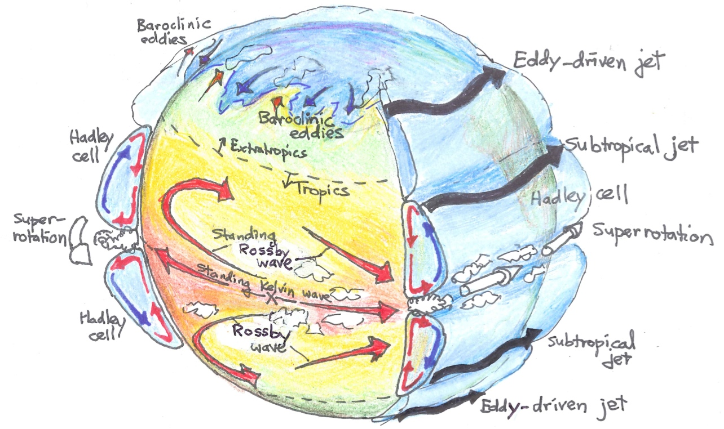
Recap of qualitative dynamical regimes:
Showman et al. (2013, “Atmospheric circulation of terrestrial exoplanets” in the book Comparative Climatology of Terrestrial Planets)

Slide 3
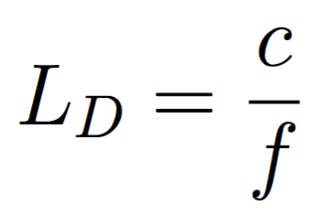
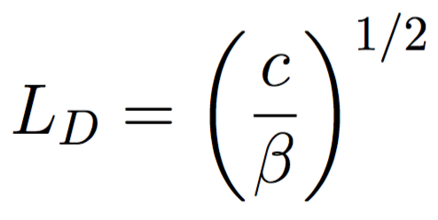
Key dynamical length scales
In the extratropics, the natural horizontal length scale associated with geostrophic adjustment (and other processes involving the interaction of gravity and rotation) is the Rossby deformation radius,
where c is the gravity wave speed. In the tropics the equivalent natural length scale, called the equatorial deformation radius, is
where β=df/dy is the gradient of the Coriolis parameter with northward distance, y.

Slide 4
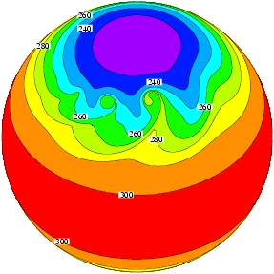
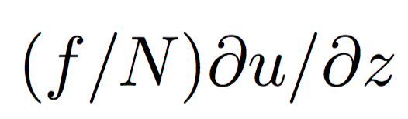
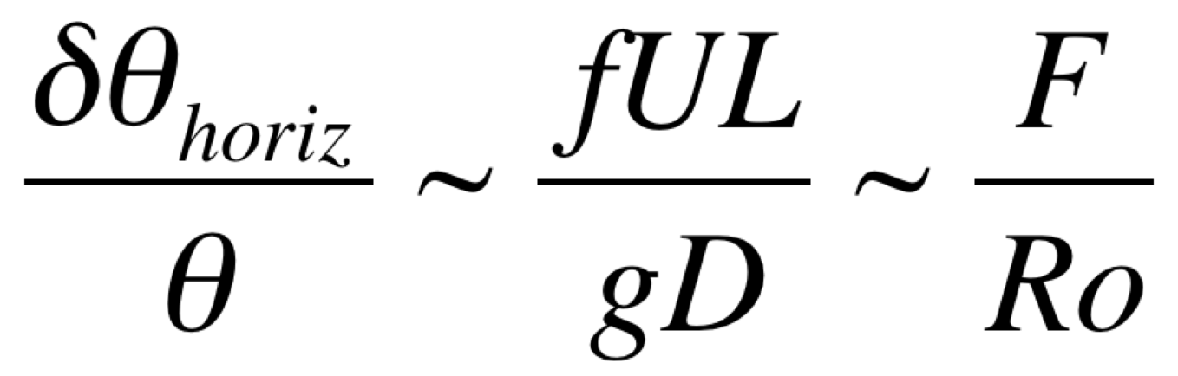
Extratropics
Ro << 1; dynamics is in geostrophic balance
Geostrophy enables large horizontal temperature contrasts (cf Charney 1963)
where F=U²/gD is a Froude number and Ro=U/fL is the Rossby number. Here D is the depth of the system, U is wind speed, f is Coriolis parameter, L is horizontal lengthscale, and g is gravity. For Earth-like parameters, we obtain a temperature difference of ~0.01.
Large horizontal temperature contrasts and sloping isentropes imply that extratropics are generally baroclinically unstable. In analytic theory, the most unstable zonal wavelength is typically ~4L_{D}, with growth rates scaling with
For Earth-like conditions, these imply length scales of ~4000 km and growth timescales of 3-5 days.
Baroclinic instabilities generate eddies that dominate much of the dynamics, controlling equator-pole heat fluxes, temperature contrasts, meridional mixing rates, vertical stratification, and jet formation

Slide 5
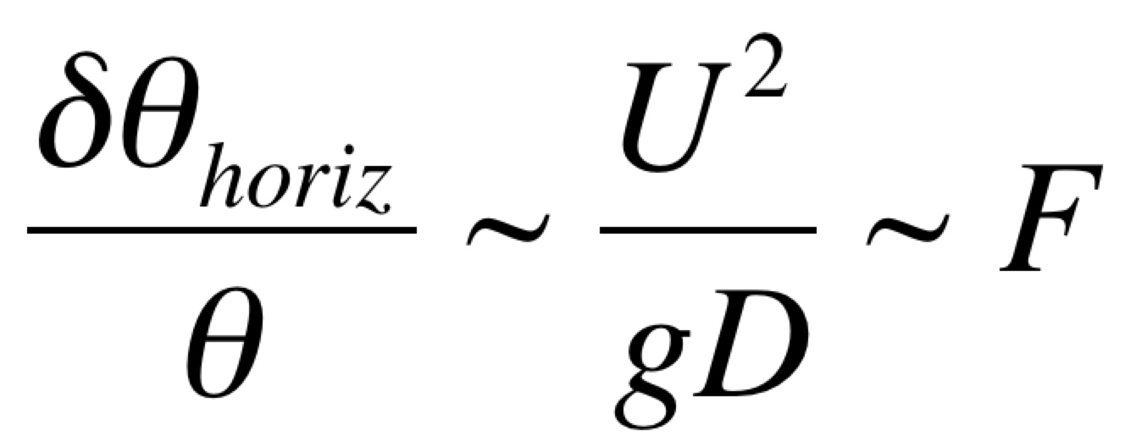
Tropics
Ro ~ 1; dynamics is inherently ageostrophic
Horizontal temperature contrasts tend to be small (cf Charney 1963)
which is significantly smaller than in the extratropical case. Inserting Earth parameters gives ~0.001.
Baroclinic instability less important or negligible (compared to the extratropics)
Temperature structure regulated by Hadley circulations and wave adjustment, contributing to the relatively small horizontal temperature differences, the so-called “weak temperature gradient” or WTG regime.

Slide 6
Let’s look at some GCM experiments to illustrate these mechanisms and address the following questions:
How do fundamental mechanisms of atmospheric circulation vary with rotation rate, atmospheric mass/composition, incident stellar flux, etc? How do these parameters affect strength, width, location, properties of Hadley cell, jet streams, mixing rates, temperature distributions, wind speeds, etc?
Why are equator-to-pole temperature differences on Venus and Titan so much smaller than on Earth? Why is that of Mars greater? What controls the equator-pole temperature contrast generally?
Implications for habitability?
Implications for observations of terrestrial exoplanets?

Slide 7
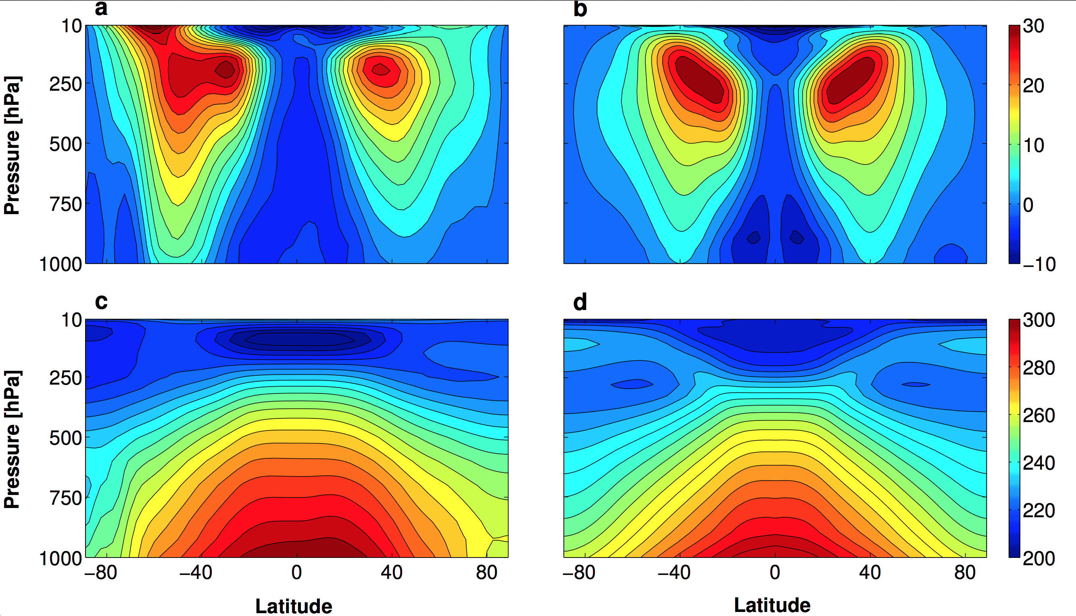
Observations
Reference Earth GCM experiment
Kaspi & Showman (2015)

Slide 8
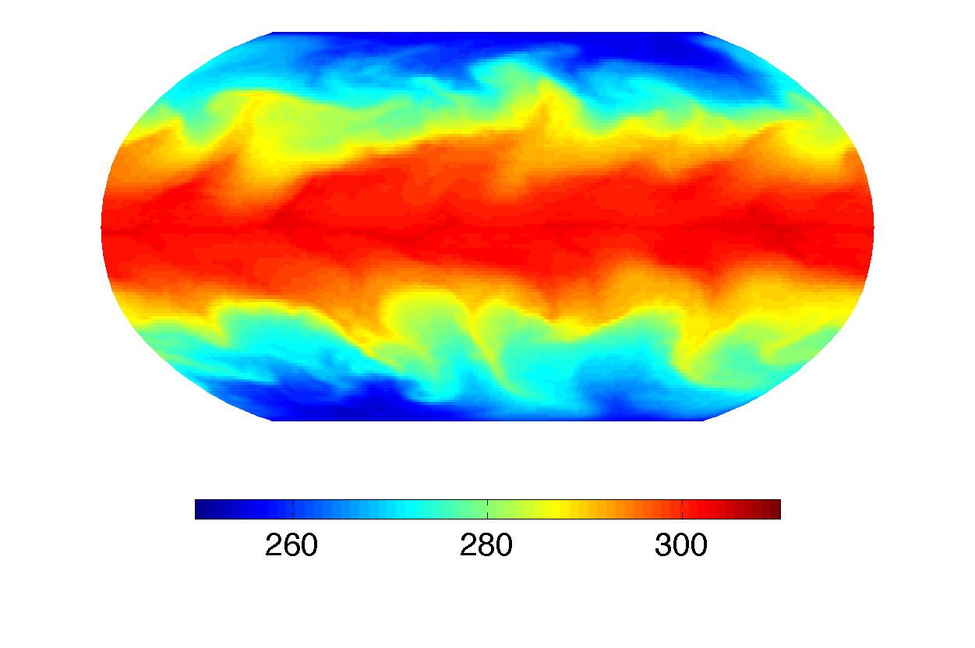
Meridional temperature distribution (Earth case)
Energy flux (PW)
Energy flux (PW)
Latitude
Latitude
m = moist static energy
temperature
geopotential
specific humidity
latent heat of vaporization
Kaspi & Showman (2015)
Notes:
Lets begin with Earth for reference. If there were no dynamics on earth the pole to Eq temp diff would have been much larger. The reason it is reduced by dynamics is because there is a poleward heat transport of erengy which we are showing here through looking at the moist static energy flux which is the total amount of static energy in the atmosphere. You can see that it is positive meaning a flux from Eq to pole. The dashed line is the eddy component and it is the mosit static energy due to turbulence and you can see that it dominates the sum. We can further divide this turbuelnt transport into a dry and moist components where the dry one is these first terms here and the mist one is this latent energy term here. You can see that on Earth the moist one is more dominant in low latitues and the dry one at high latitudes and over all they about equally contribute to the sum which is this black line here. To demonstate this we can look at the surface temperature for an Earth case and you can see how the turbulrnce transferes heat polewards.

Slide 9
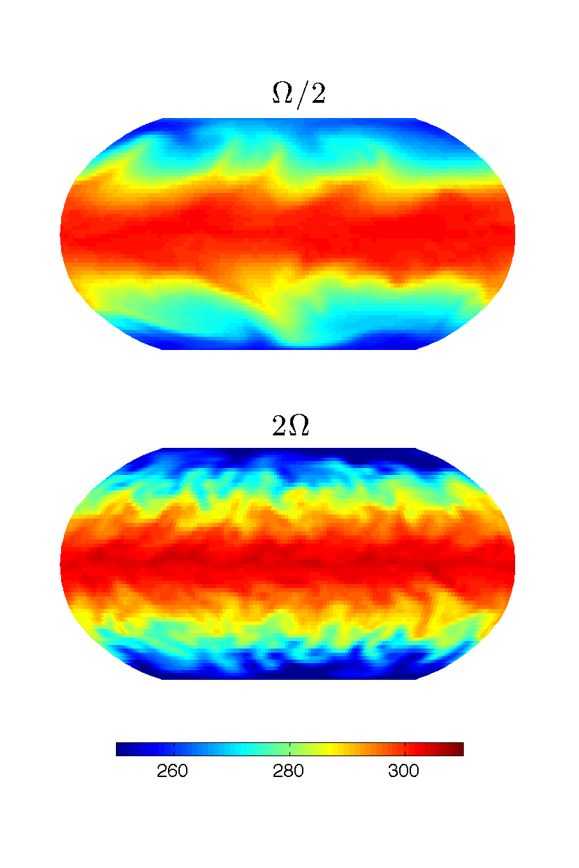
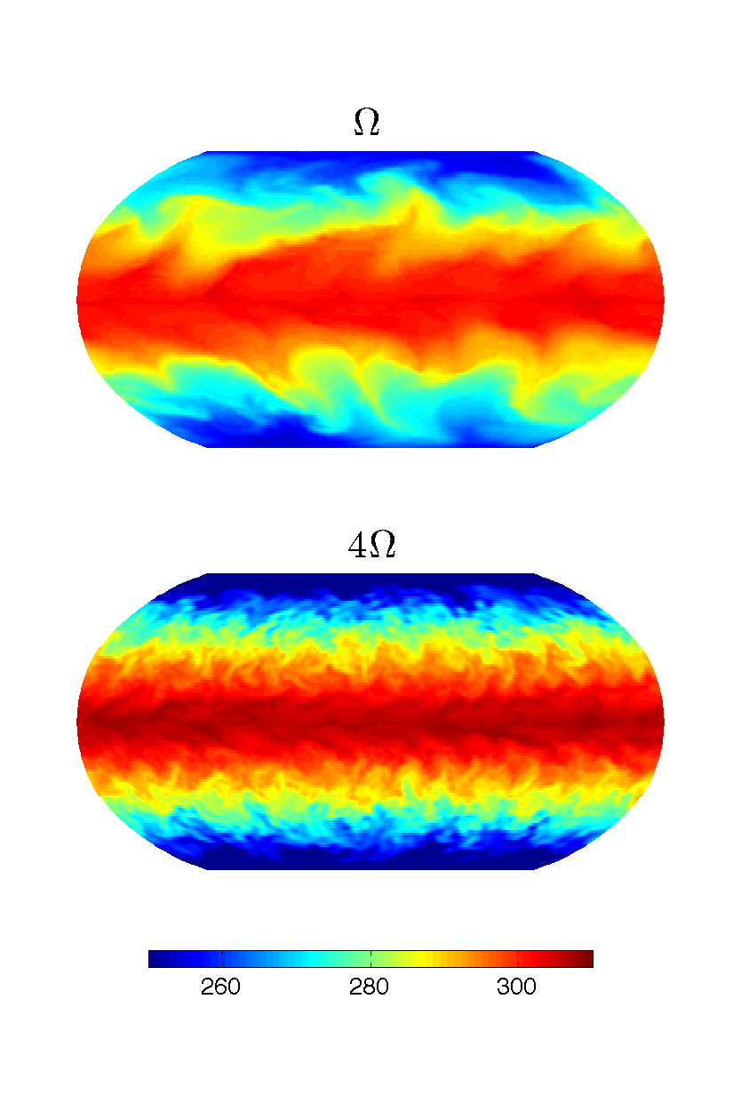
Effect of planetary rotation on baroclinic eddies
Kaspi & Showman (2015)
Eddy length scale decreases inversely with rotation rate, as expected from analytic theory. Note the greater equator-pole temperature differences at high rotation rate.
Notes:
Now lets look a different rotation rate cases…

Slide 10
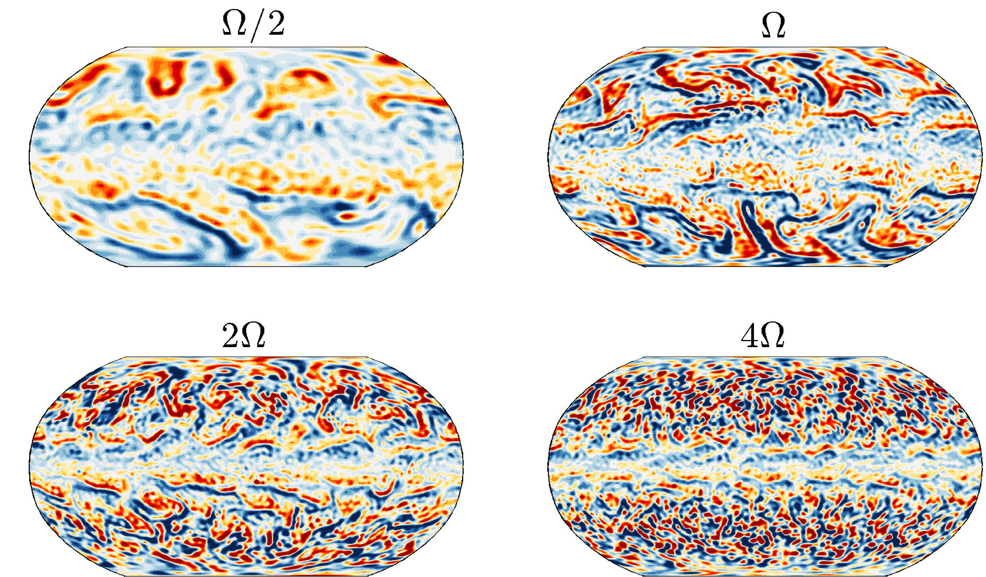
Mid-troposphere vorticity
Kaspi & Showman (2015)

Slide 11
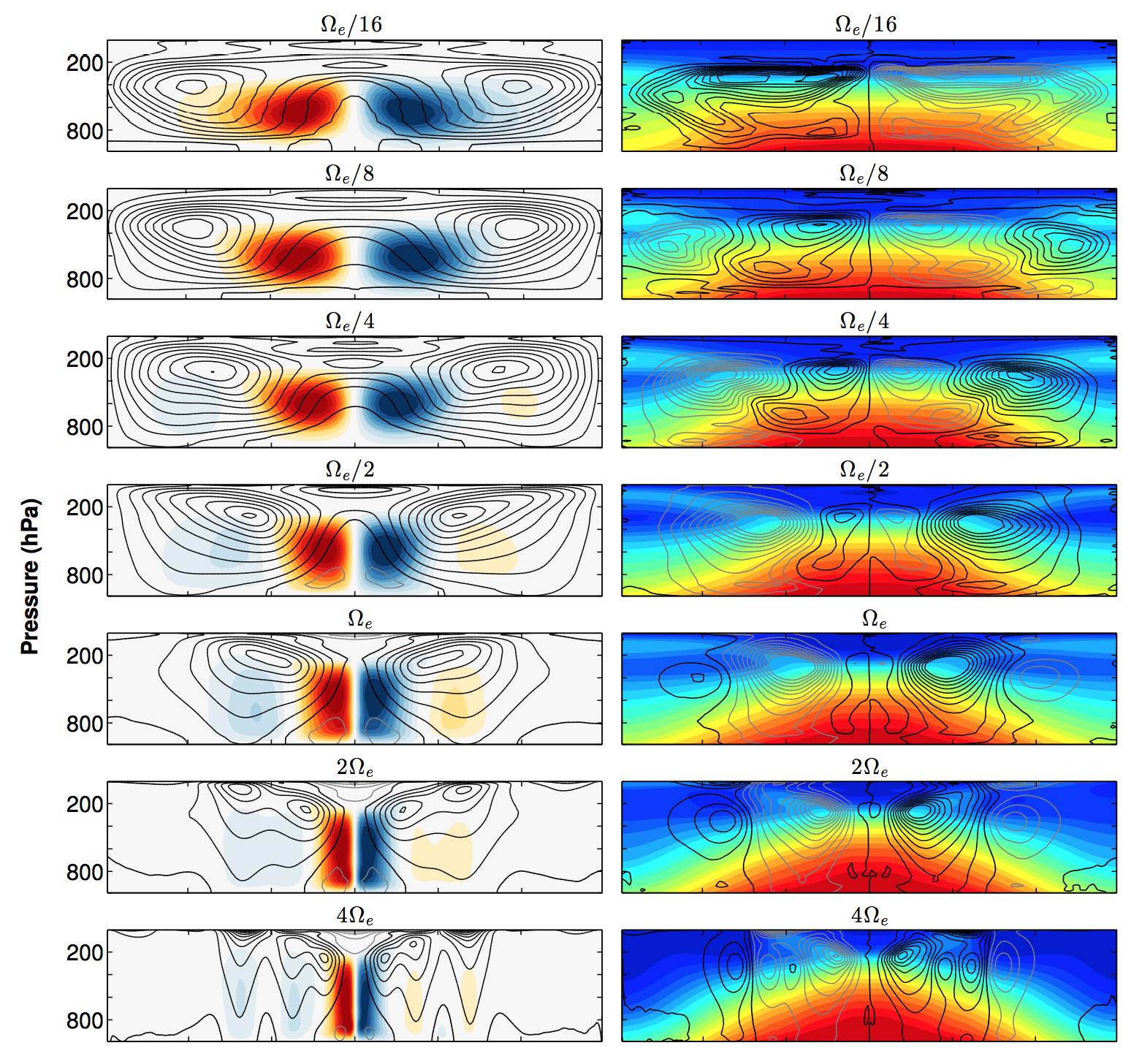
Effect of planetary rotation
Temp (color)
mom flux
(contours)
Streamfunction
(color)
zonal wind
(contours)
Width of Hadley cell (HC) increases with decreasing rotation rate, becoming nearly global at the slowest rotation rates.
At fast rotation rates, the HC is confined near the equator, and the baroclinic zone exhibits multiple eddy-driven jets.
Kaspi & Showman (2015)

Slide 12
Effect of planetary rotation
The smaller eddies in the more rapidly rotating models are less efficient at transporting thermal energy, and the Hadley cell is narrower, both of which contribute to greater equator-to-pole temperature difference at fast rotation rate.
Equator to pole temp. diff.
Meridional energy flux (PW)
Rotation Period (hours)
Rotation Period (hours)
Kaspi & Showman (2015)

Slide 13
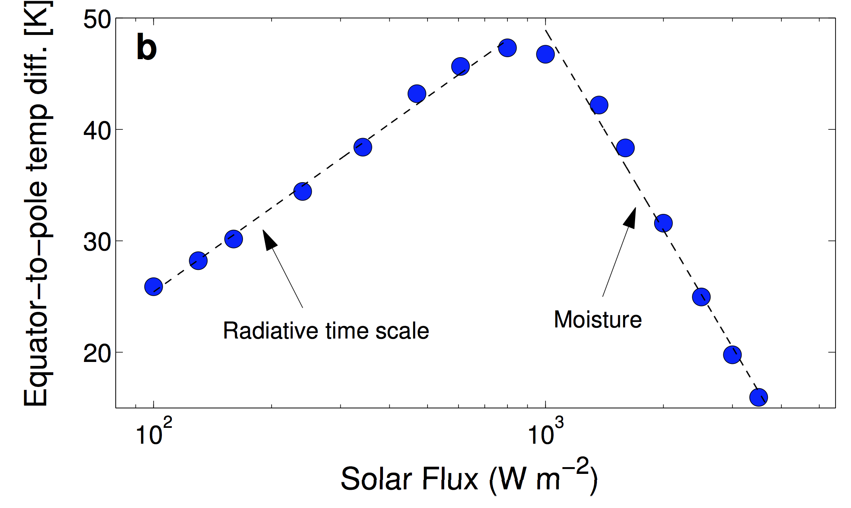
Incident stellar flux
Surface temperature
Latitude
Latitude (deg)
Kaspi & Showman (2015)
Notes:
Check mse itself – equator to pole difference
And, do a dry sequence of models across the same range of stellar flux

Slide 14
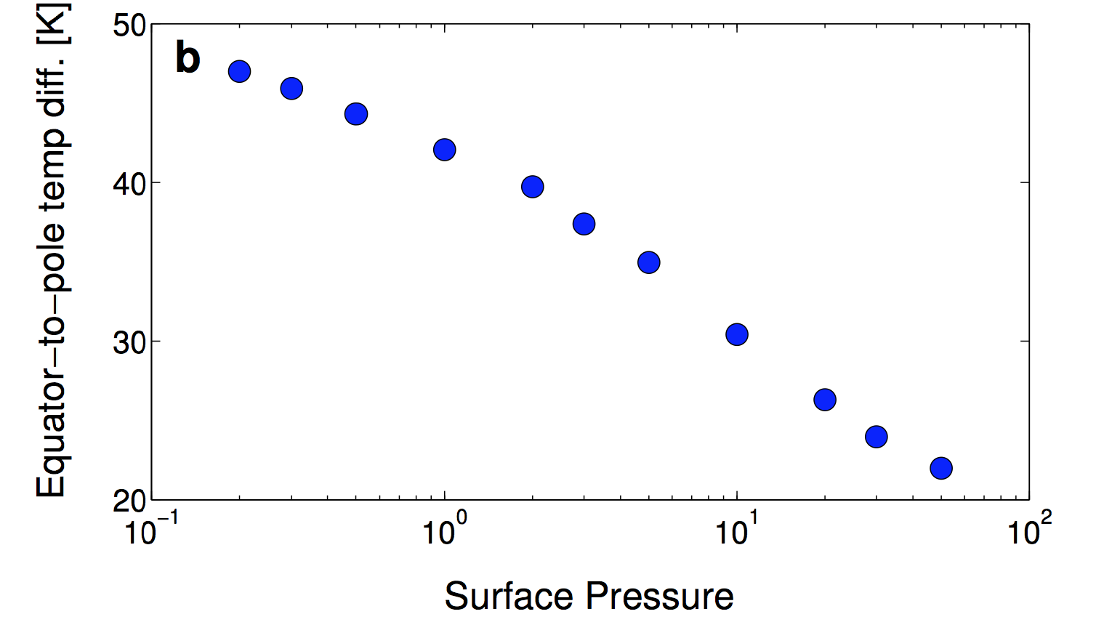
Atmospheric Mass
Vary surface pressure, keeping gravity constant at Earth value
Surface temperature
Energy flux (PW)
Latitude
Latitude
Kaspi & Showman (2015)
(bar)
Notes:
More massive atmosphere = more heat transport

Slide 15
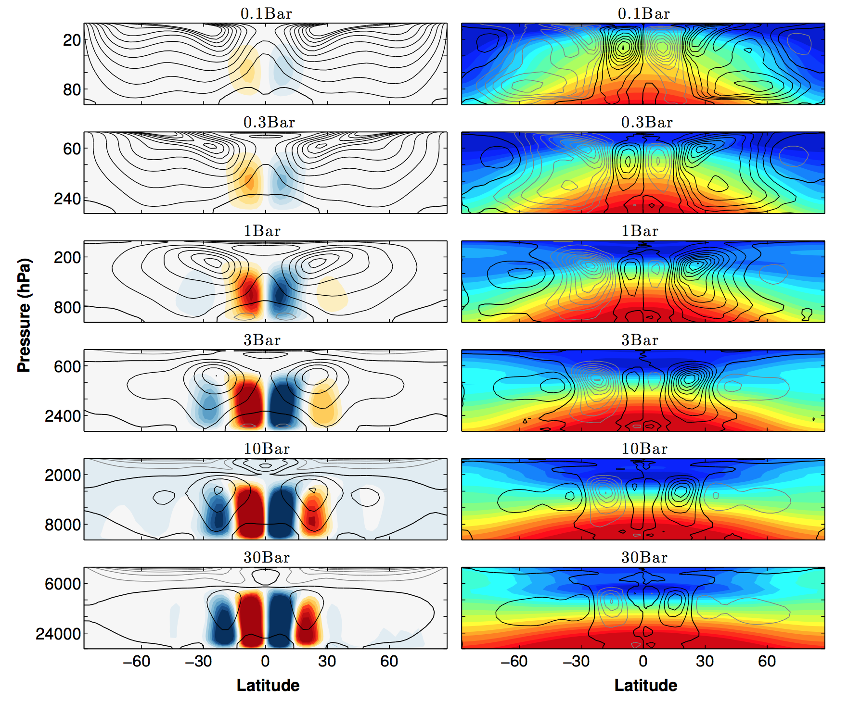

Slide 16
Summary
Rotation rate, atmospheric mass, solar constant, planetary mass and planetary mean density have an order unity affect on the dynamical structure of the circulation, including the equator to pole temperature gradient.
The equator to pole temperature gradient is important in characterizing climate and habitability (e.g., it is important for determining whether a planet can enter a snowball state).
Temperature gradients increase
Temperature gradients decrease
Faster rotation
Larger planetary mass
Larger planetary density
Larger atmospheric mass
Larger solar flux
Larger radiative time scale

Slide 17
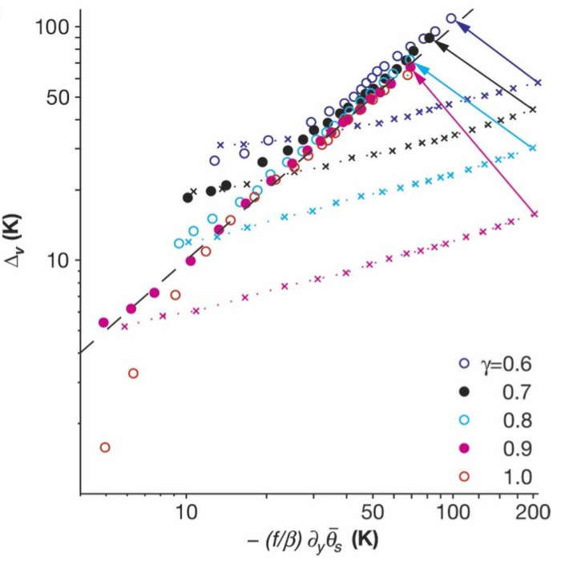
Extratropics: Role of baroclinic eddies in controlling thermal structure
Some numerical evidence suggests that baroclinic instabilities cause the extratropics to adjust to a state where isentropes slope by a scale height over a planetary radius (implying that vertical stratification scales with meridional temperature gradient). This could explain this property of Earth’s extratropics. More on this in the lecture on jets.
Vertical stratification
Schneider & Walker (2006)
Meridional temperature gradient

Slide 18
Rossby waves

Slide 19
Mechanisms of extratropical jet formation: role of Rossby waves
Group
propagation
In the extratropics, regions of Rossby wave generation correspond to eastward eddy-driven jets. Regions of Rossby wave damping correspond to westward flow.
Phase
propagation
Phase
propagation
Group
propagation

Slide 20
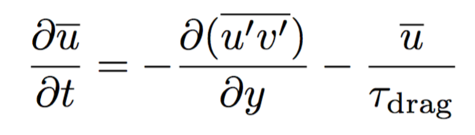
Mechanisms of jet formation: role of Rossby waves
Group
propagation
Phase
propagation
u’v’<0
The eddy acceleration term is positive (eastward) in the region of Rossby wave generation, and negative (westward) in the region of Rossby wave damping/breaking.
Phase
propagation
u’v’>0
Group
propagation

Slide 21
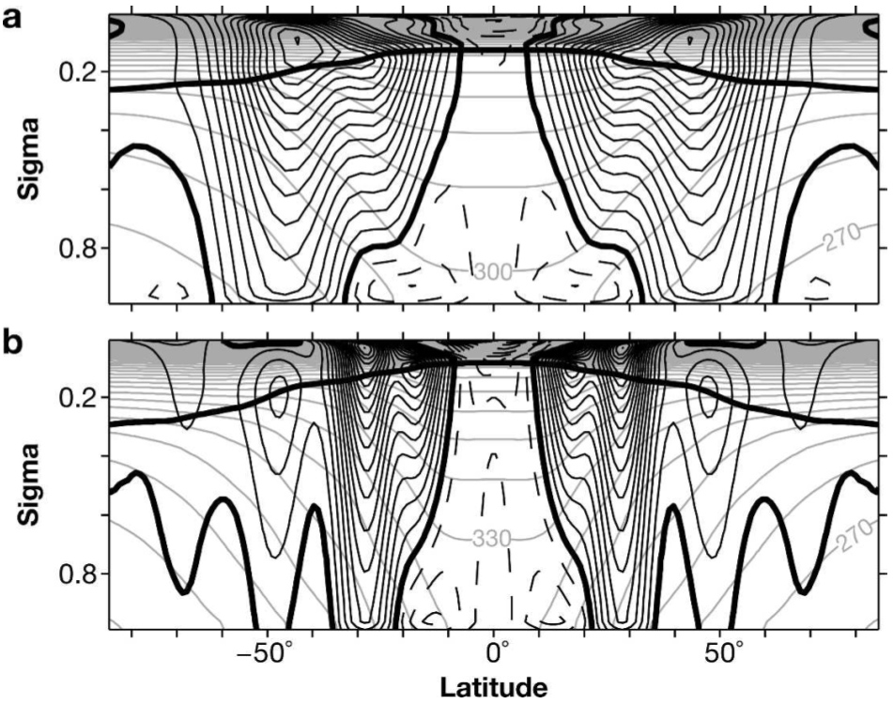
Zonal jets
Schneider & Walker (2006)

Slide 22

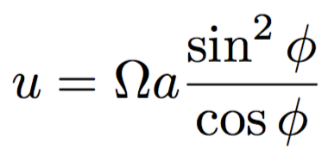
Hadley circulation
Regulates the thermal structure in the tropics. Exerts a significant effect on the mean climate. Although the real Hadley cell has strong 3D structure, it can be idealized as a 2D circulation—unlike the case of heat transport by baroclinic eddies in the extratropics.
All the terrestrial planets with thick atmospheres—Earth, Mars, Venus, Titan—have Hadley circulations.
Planetary rotation exerts strong control over the Hadley circulation. It’s useful to think about the limit where the upper branch conserves angular momentum about the rotation axis,
where a is planetary radius. If the ascending branch is at the equator and exhibits zero zonal wind, then the zonal wind in the upper (poleward flowing) branch is
For Earth conditions, this yields wind speeds of 134 m/s, 1000 m/s, and infinite at latitudes of 30º, 67º, and the poles. This is of course impossible, and implies that rotation, if sufficiently strong, will confine the Hadley circulation to low latitudes.
This eastward upper tropospheric wind, which peaks near the outer edge of the Hadley cell, is the subtropical jet.

Slide 23
Effect of planetary rotation
Streamfunction
(color)
zonal wind
(contours)
Temp (color)
mom flux
(contours)
Note how width of Hadley cell increases with decreasing rotation rate, becoming nearly global at the slowest rotation rates.
Temperature gradients are relatively weak across most of the Hadley cell.
Kaspi & Showman (2015)

Slide 24
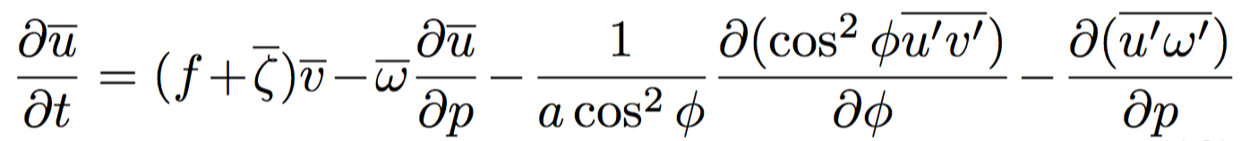
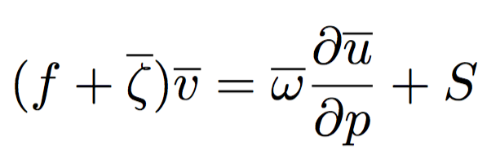

Hadley circulation
The Hadley circulation can exhibit different regimes depending on the extent to which the upper branch is angular-momentum conserving. Consider the zonal-mean zonal wind equation from 3D primitive equations, using pressure as a vertical coordinate:
where ω=dp/dt is the vertical velocity in pressure coordinates. Overbars and primes denote zonal means and deviations therefrom. Denote the eddy terms by –S and consider the statistical steady state:
For Earth, the first term on the right side is not dominant, so that we can write (e.g., Held 2000, Walker & Schneider 2006):
where Ro_{H} = -ζ/f is a Rossby number associated with the Hadley circulation.
Essentially, Ro_{H} is a measure of the strength of eddies on the Hadley cell, which exhibits different behaviors depending on whether Ro_{H} is large or small.

Slide 25
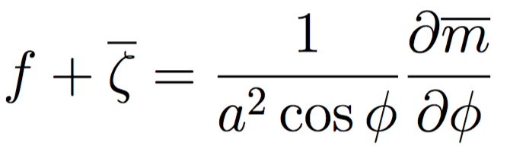
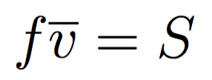
Hadley circulation
The Hadley circulation exhibits different behavior depending on whether Ro_{H} is large or small.
When eddy accelerations are negligible, then S=0, and for non-zero circulations the absolute vorticity must therefore be zero within the upper branch, i.e., f+ζ=0, or, in other words, Ro_{H}→1. The definitions of relative vorticity and angular momentum imply that
A circulation with zero absolute vorticity therefore exhibits angular momentum that is constant with latitude. This is simply the angular-momentum conserving limit. The Hadley cell in this limit is thermally driven.
On the other hand, eddy accelerations are often important in shaping the Hadley circulation. If Ro_{H}<<1, then the zonal momentum balance is
which means that the strength of the Hadley circulation is solely controlled by the amplitude of the eddy acceleration (and not, at least directly, by thermal forcing).
Real Hadley circulations lie between these two extremes.

Slide 26
Hadley circulations
For Earth and Mars, the primary eddy effects result from absorption of equatorward-propagating Rossby waves that reach critical levels on the flanks of the subtropical jets. These waves break and cause a net westward torque, removing angular momentum.
This implies that the angular momentum in the upper branch decreases with latitude away from the equator, and helps explain why the subtropical jet is a factor of several weaker than the angular-momentum conserving limit would suggest.
There is strong seasonality—if the rising branch is located off the equator, as occurs during solstice, then the so-called “winter cell” (the cell that crosses over the equator into the winter hemisphere) will have strongly westward winds near the equator, which tend to lack critical levels and is therefore relatively transparent to the waves.
Ro_{H} varies from ~0.3-0.4 in the equinoctal and summer cells to ~0.7-0.8 in the winter cell (Schneider & Bordoni 2008, Bordoni & Schneider 2008).

Slide 27
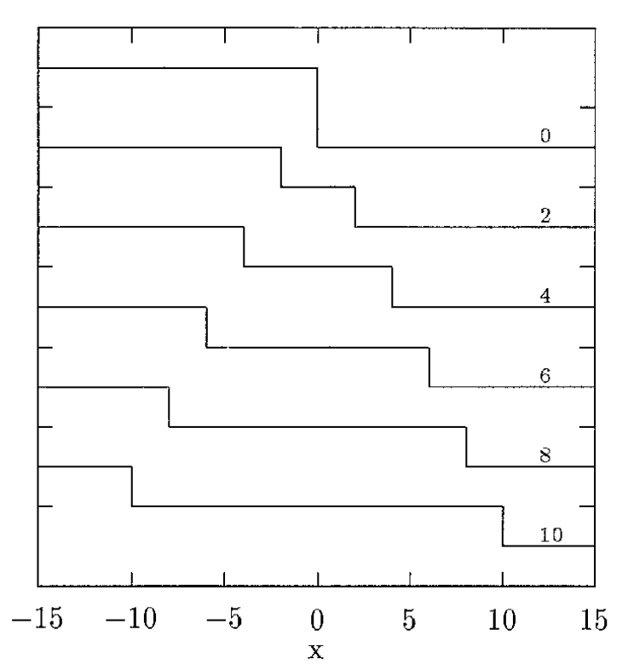
Wave adjustment
The “dam break” problem for the non-rotating case:
Kuo & Polvani (1997)

Slide 28

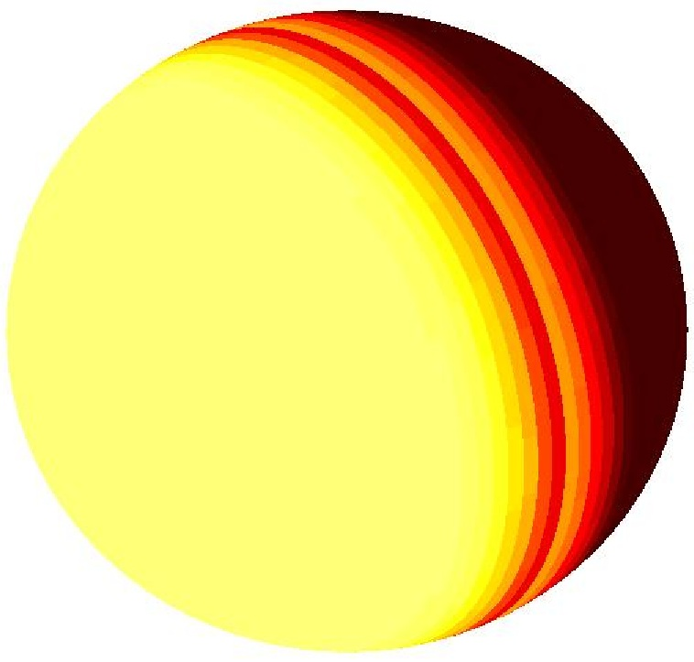
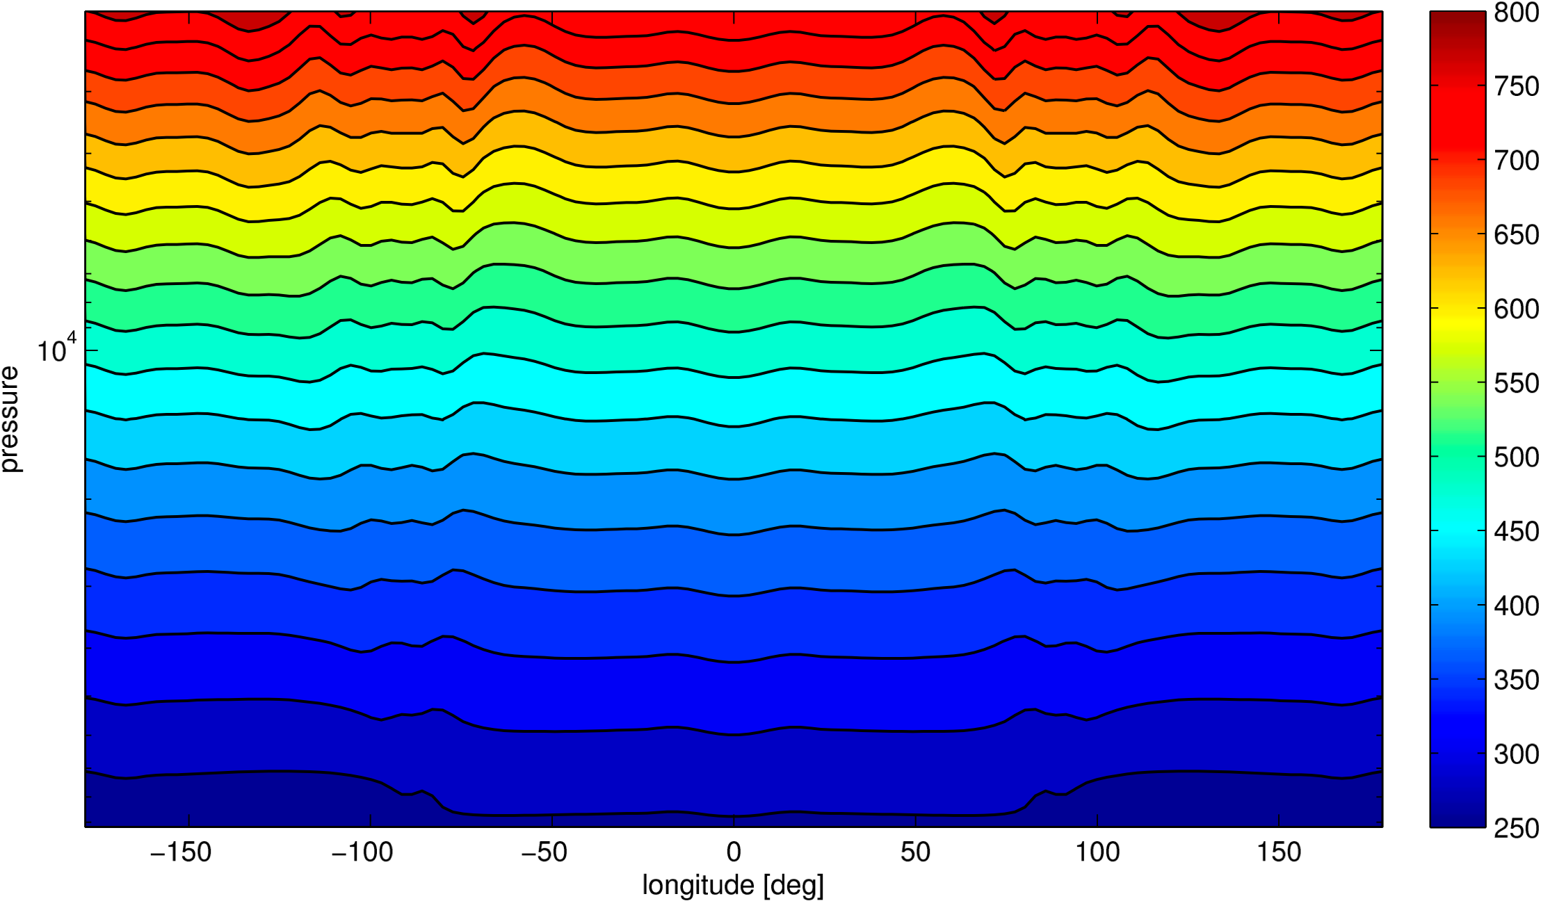
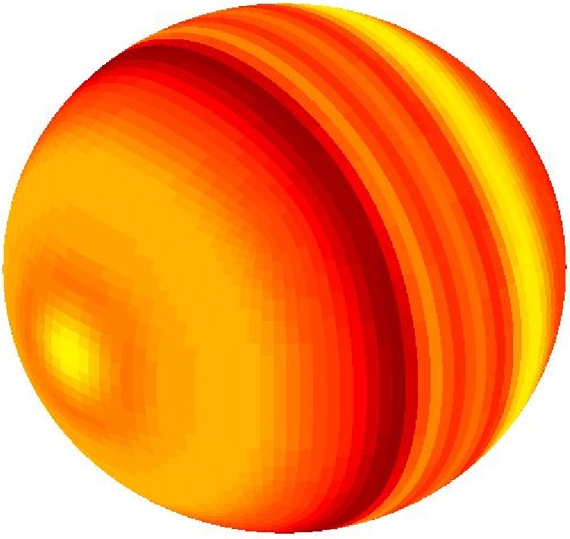
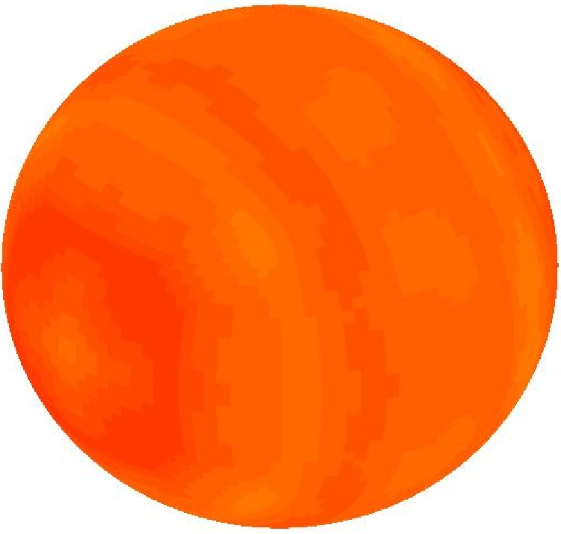
In a 3D tropical atmosphere, wave adjustment erases horizontal temperature differences
Showman et al. (2013, “Atmospheric circulation of terrestrial exoplanets” in the book Comparative Climatology of Terrestrial Planets)

Slide 29
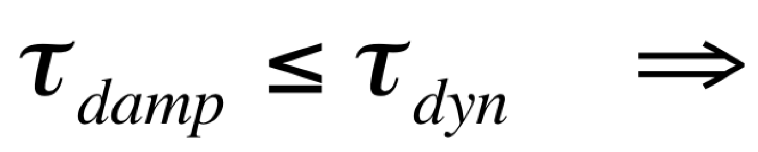
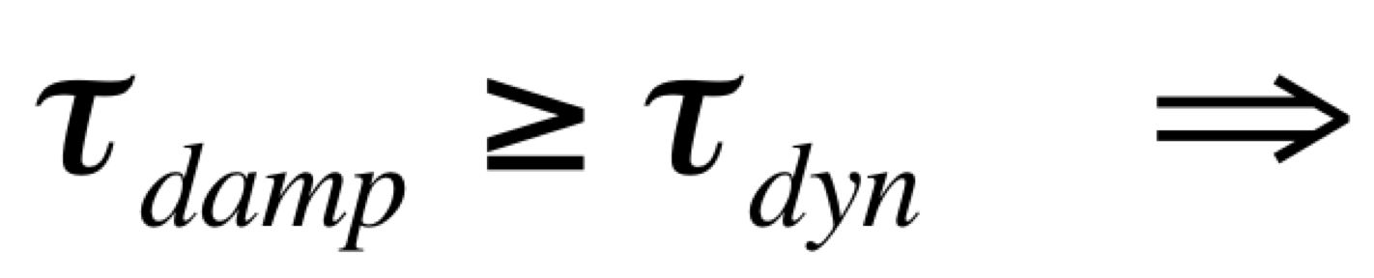
Timescale arguments associated with adjustment
Generally one might crudely expect that if
small fractional temperature differences
large fractional temperature differences
Relevant damping timescales include friction and radiative timescales. Dynamical timescales can be horizontal wave propagation timescales, although advection and rotation timescales may be relevant. The precise timescale comparison is thus probably more complex than shown above (e.g., see Komacek & Showman 2016).
The adjustment timescale is often much shorter than the mixing timescale.
For synchronously rotating Earth-like planets, these arguments suggest large temperature differences if atmospheric pressure < 0.1 bar. For hot Jupiters, they suggest large temperture differences if the planet is hot enough.
This has important implications for atmospheric collapse on synchronously rotating planets (e.g., Joshi et al. 1997), and for explaining IR data for hot Jupiters.
~

Slide 30
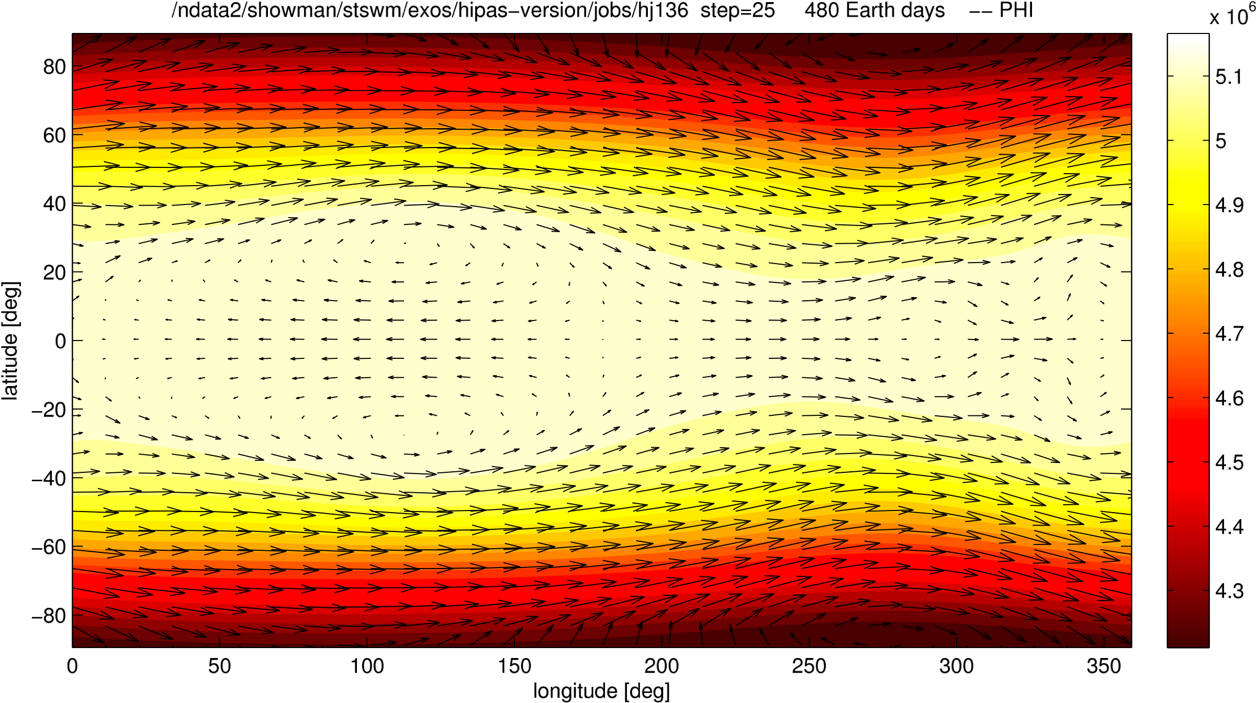
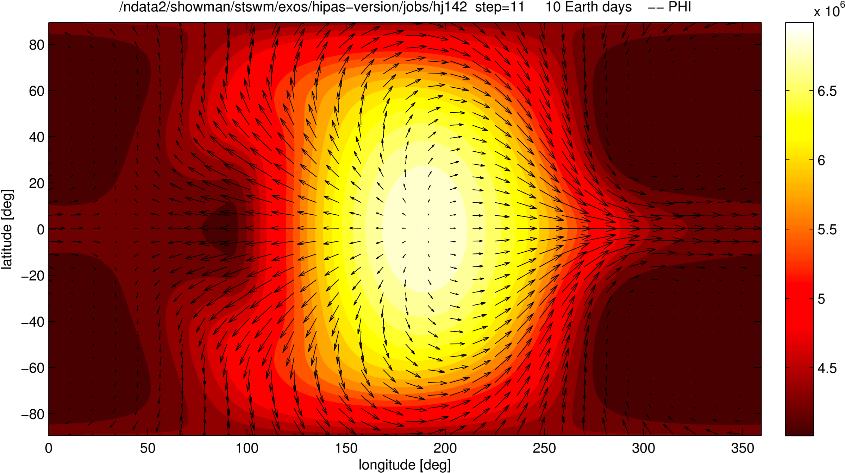
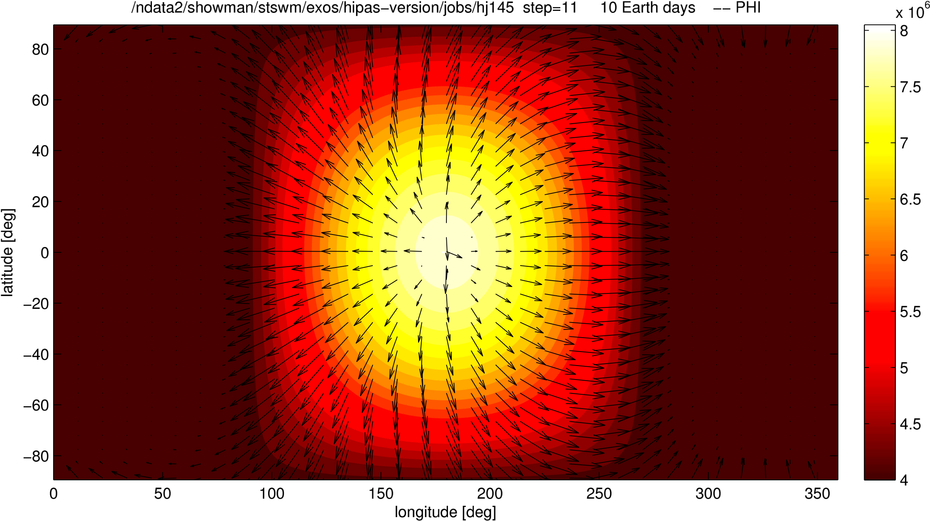
Weak damping
Moderate damping
Strong damping

Slide 31
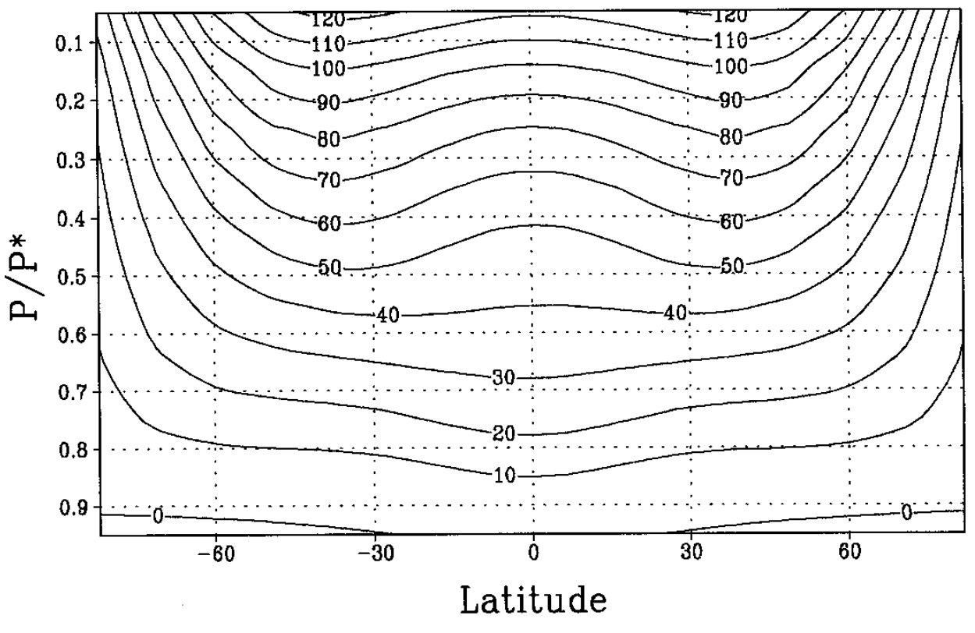
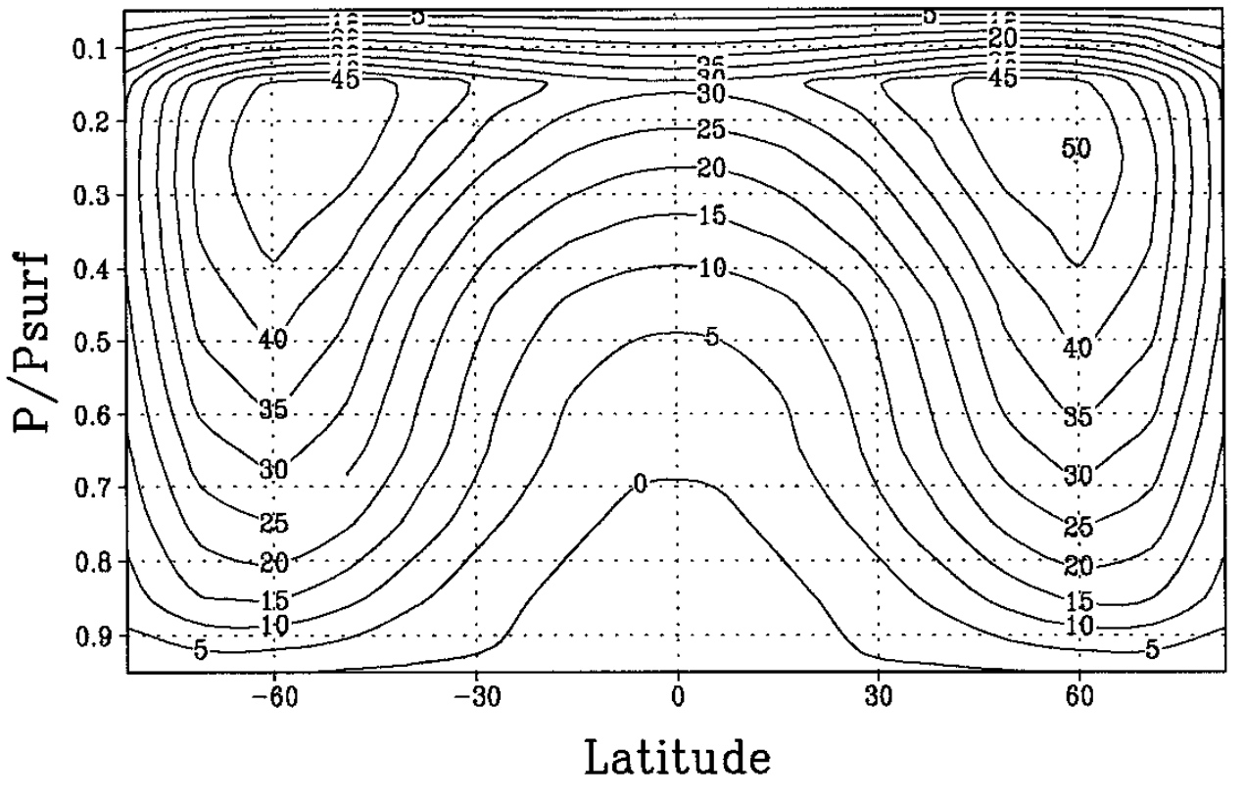
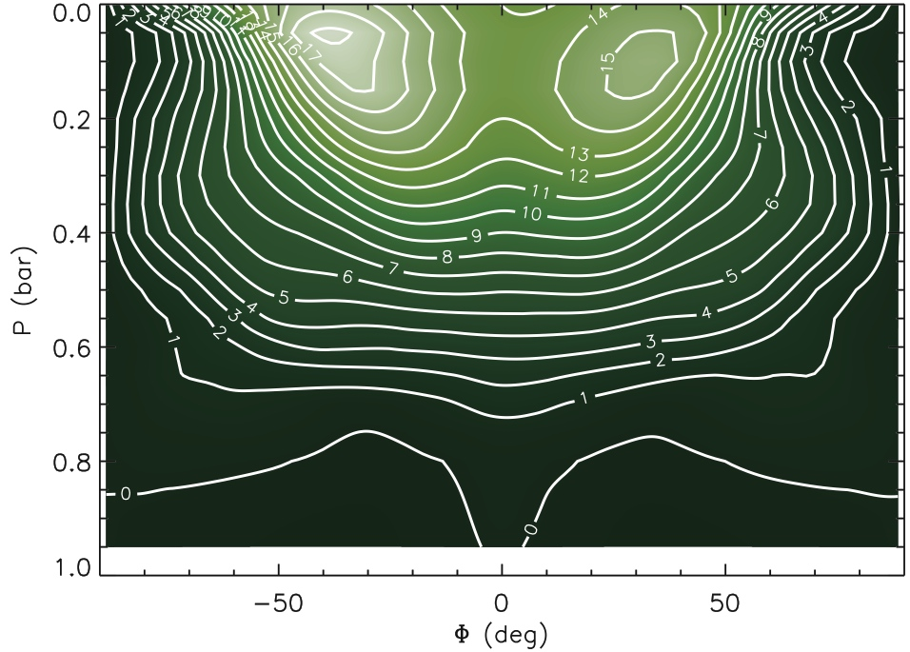
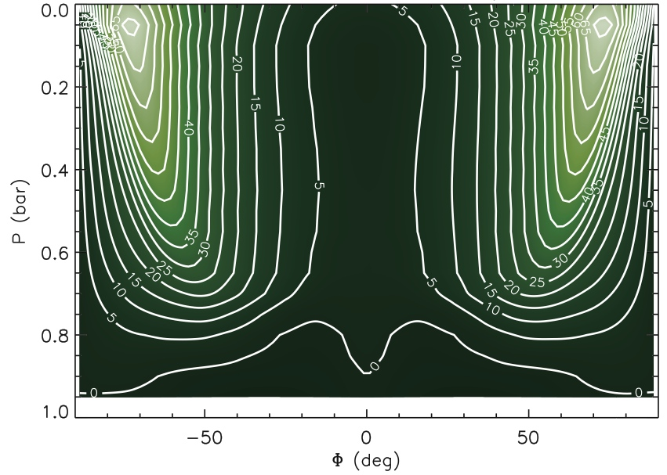
Equatorial superrotation is expected on tidally locked exoplanets
Synchronously locked
Axisymmetric forcing
Joshi et al. (1997)
Heng & Vogt (2010)
See also Merlis & Schneider (2010), Wordsworth et al. (2011), Edson et al. (2011)

Slide 32
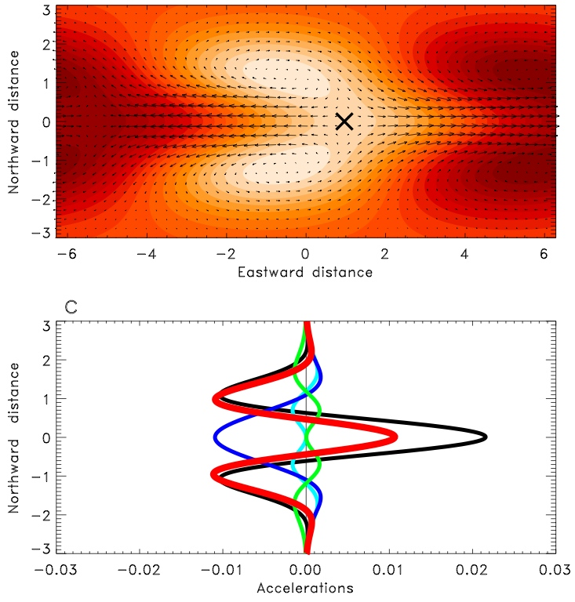
Showman & Polvani (2011) showed that the superrotation results from momentum transport by standing, planetary-scale waves driven by the day-night thermal forcing
Showman & Polvani (2 011, ApJ 738, 71)

Slide 33
That’s it for theoretical aspects.
Now let’s do a brief observational tour of the Solar System’s terrestrial planet climates.

Slide 34
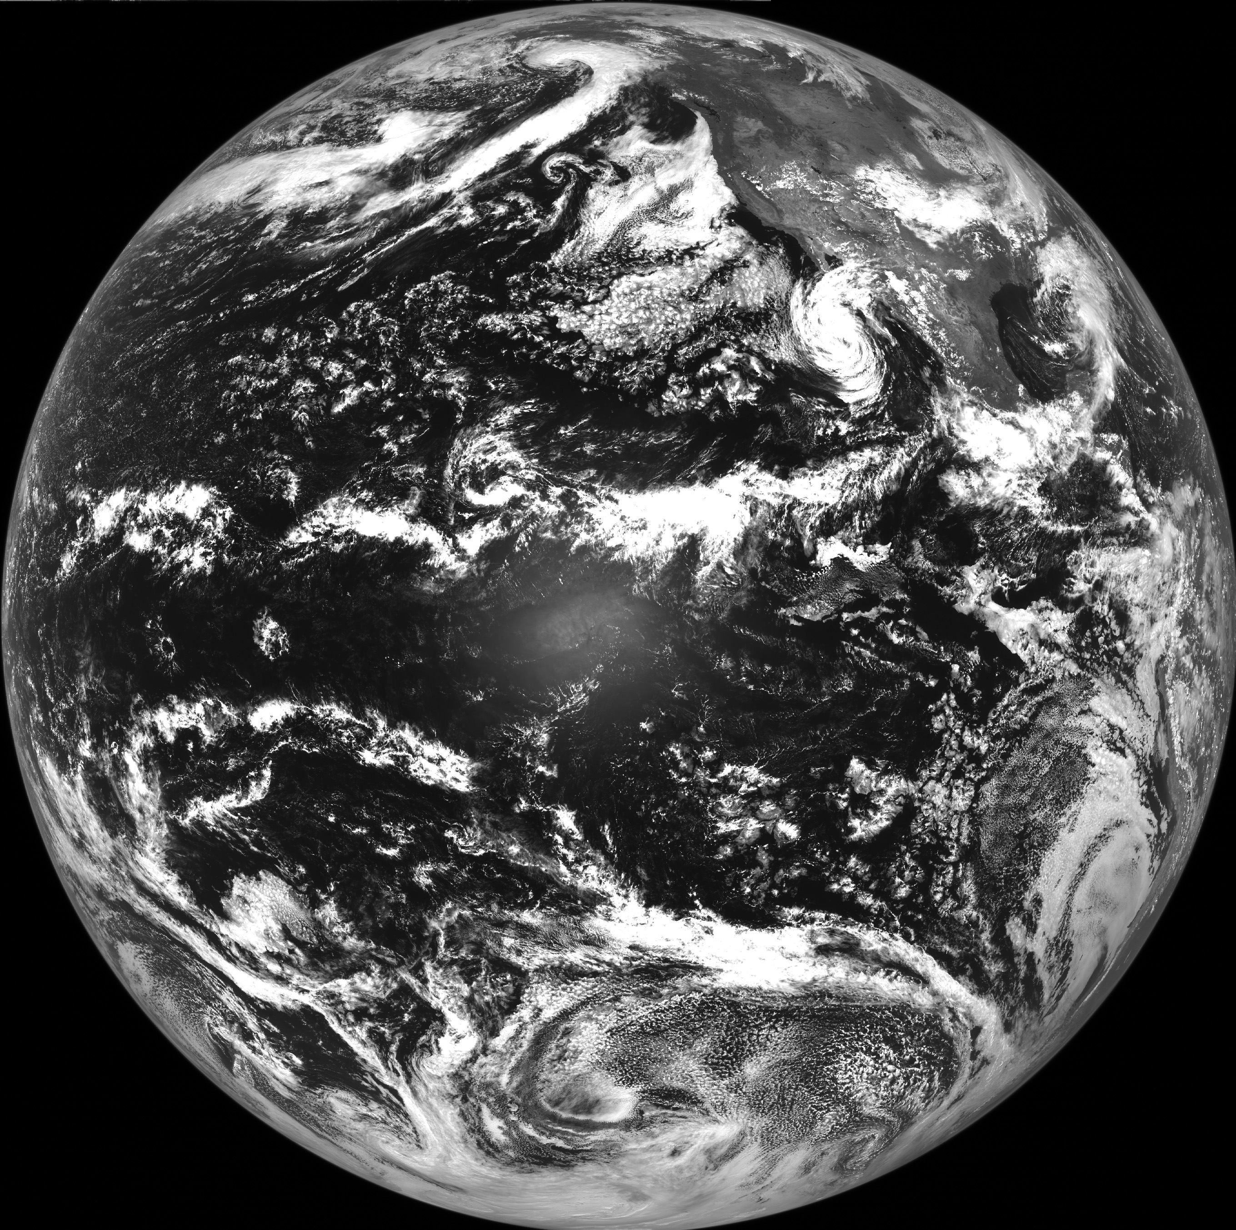
Earth as a planet
Earth is the largest terrestrial planet, with a 1-bar N₂ atmosphere and trace amounts of CO₂ and water vapor sufficient to keep temperatures above freezing.
The 3.7-km deep ocean is 260 times the atmosphere mass, implying that Earth has more fluid volatiles at its surface than any other solid object in the solar system.
Viewing Earth as a planet leads to major questions: why is the atmosphere made mostly of N₂? Why does it have this mass? Why isn’t the ocean ten times more or less massive? Is it a coincidence that the ocean volume is large enough to cover most of the globe but small enough to allow continents to stick abovewater?
What processes control Earth’s climate—what are the fundamental global climate feedbacks, how do they interact with the circulation and how do they relate to planetary climate and habitability in general?

Slide 35
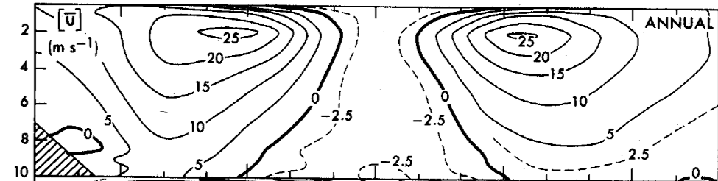
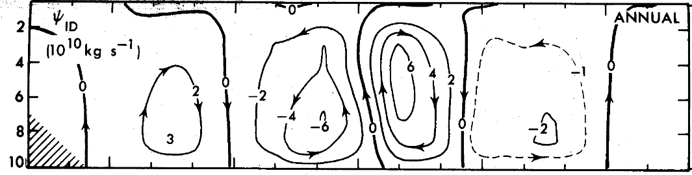
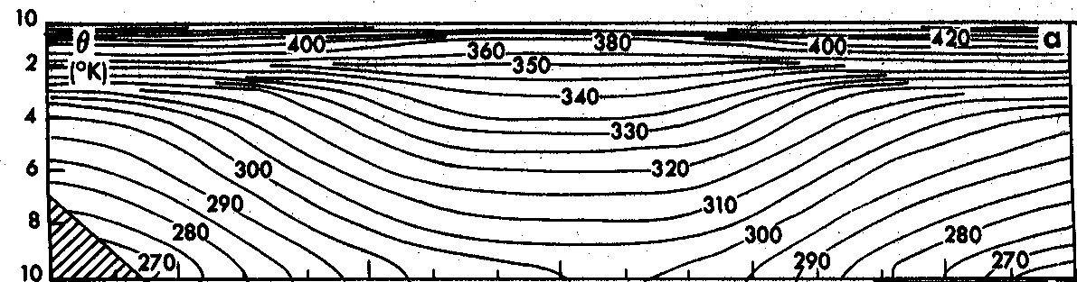
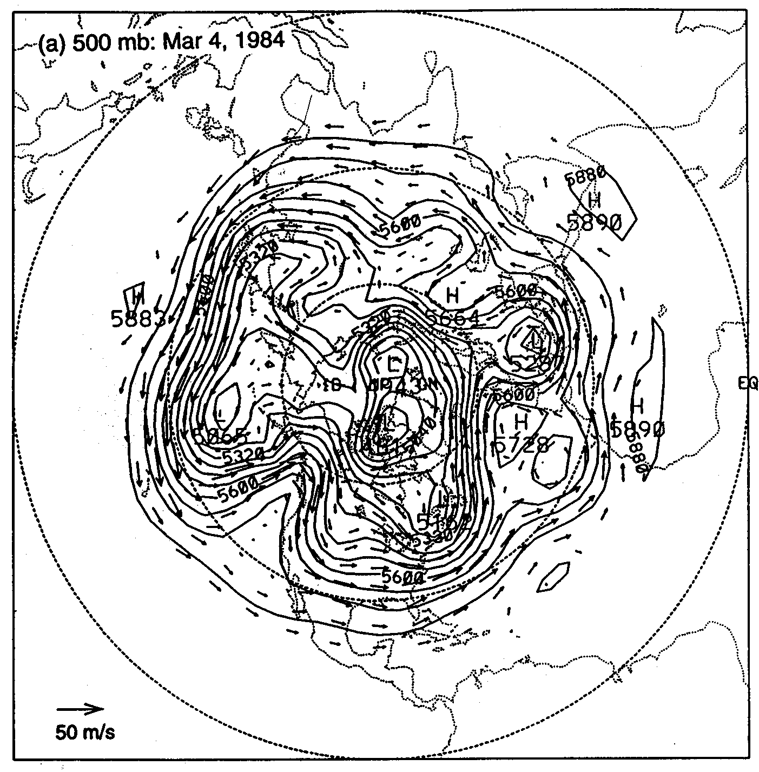
Earth as a planet: circulation
Zonal-mean zonal wind
Earth has a Hadley cell at low latitudes and a baroclinic zone at high latitudes, leading to subtropical and eddy-driven jet streams in the midlatitudes, relatively flat temperature patterns in the tropics, and steeper isentropes in the midlatitudes.
The Hadley cell transports heat poleward in the tropics, and baroclinic instabilities do so in the extratropics.
Much of this structure remains poorly understood at a deep level. We still do not have a predictive theory for what controls Hadley cell width, strength, and temperature constrasts, nor for the equator-pole temperature difference, nor for what sets the rate at which baroclinic instabilities transport heat poleward under given background conditions
Mean-meridional streamfunction
Isentropes
Answering these questions requires a “planetary perspective,”
and will be aided by comparison to other planets.

Slide 36

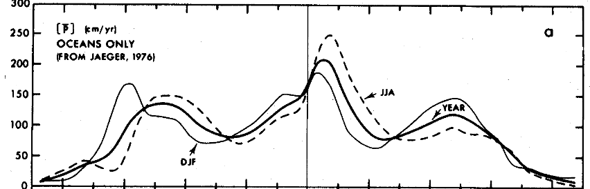
Earth precipitation/vegetation regimes are controlled by its circulation
Annual-mean
Precipitation
Width/strength of the Hadley cell and width/structure of the baroclinic zone determine the location of rainforests and deserts
So what would happen if Earth were rotating faster or slower, if the atmospheric mass were different, if the gravity were different, if the sunlight were different? These are planetary questions!

Slide 37
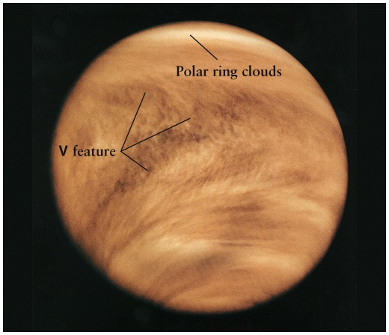
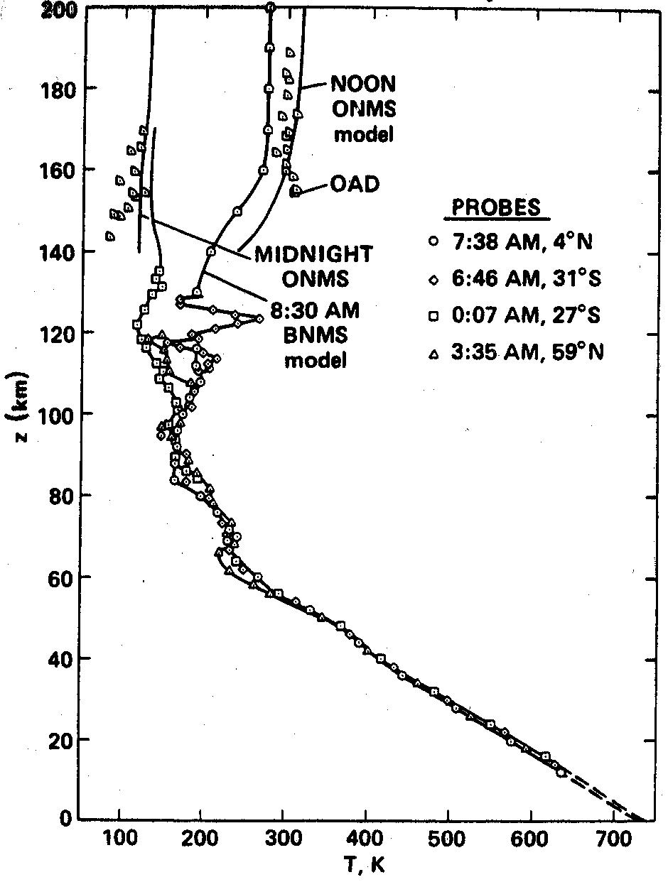
Venus
Venus, geophysically, is a near-twin of Earth: radius and mass 94% and 81% of Earth’s. Bulk interior composition probably very similar. Orbits at 0.728 AU.
But atmosphere is very different: sulfuric acid cloud layer gives bond albedo of 0.75, reflecting most of the sunlight
90 bars of CO₂ (~300,000 times more than Earth!).
Venus therefore exhibits a monstrous greenhouse effect—surface temperature of 740 K—despite absorbing less sunlight than Earth!
Venus is a slow rotator: siderial day 243 Earth days; solar day 117 Earth days. This drastically changes the dynamics (compared to Earth)
There is very little horizontal temperature variability below 60-km altitude, due to a combination of the massive atmosphere and slow rotation.

Slide 38
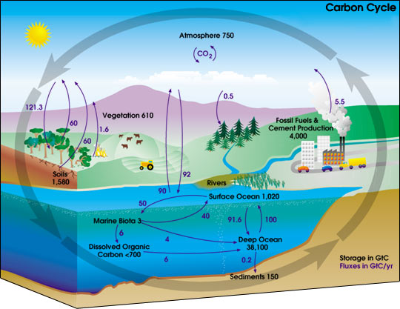
Climate: Why is Venus so different from Earth?
Earth’s CO₂ is maintained by the carbonate-silicate cycle—a climate feedbacks that keeps atmospheric CO₂ levels low and keeps most of the carbon stored in carbonate rocks.
This cycle relies on the existence of the oceans, which greatly speed up the loss of atmospheric CO₂.
Earth keeps its oceans because the atmospheric cold trap keeps water out of the upper atmosphere.
BUT if Venus ever had oceans, the cold trap may have been less effective, allowing gradual loss of ocean…. at which point CO₂ would start building up in the atmosphere. D/H on Venus is 100 times the Earth value, consistent with this idea.
This raises obvious questions: Did oceans ever exist (can we find evidence for them)? What does the high D/H ratio imply about initial water abundance? What are the noble gas abundances and what do they imply about volatile inventories supplied to Venus? What are the conditions (atmospheric composition, solar flux) under which oceans are lost? How does the carbonate-silicate feedback cycle really work on Earth or on planets in general?

Slide 39
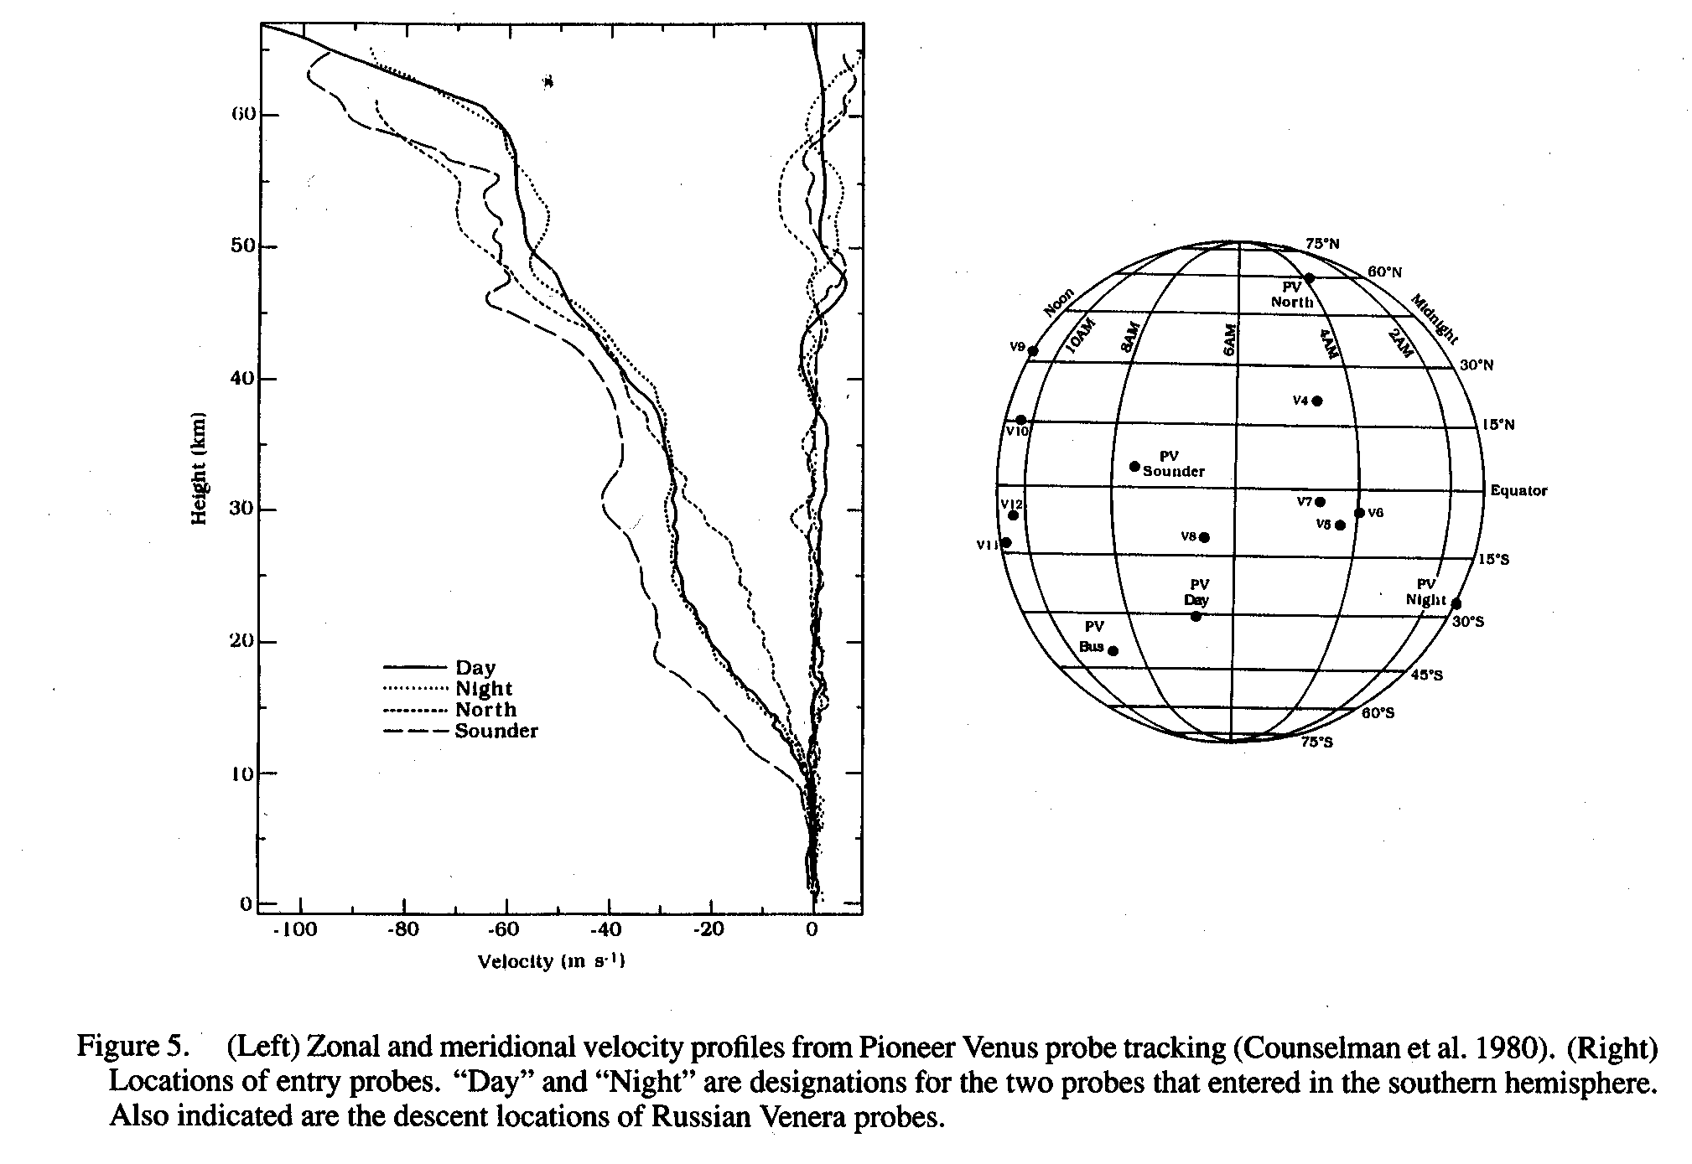
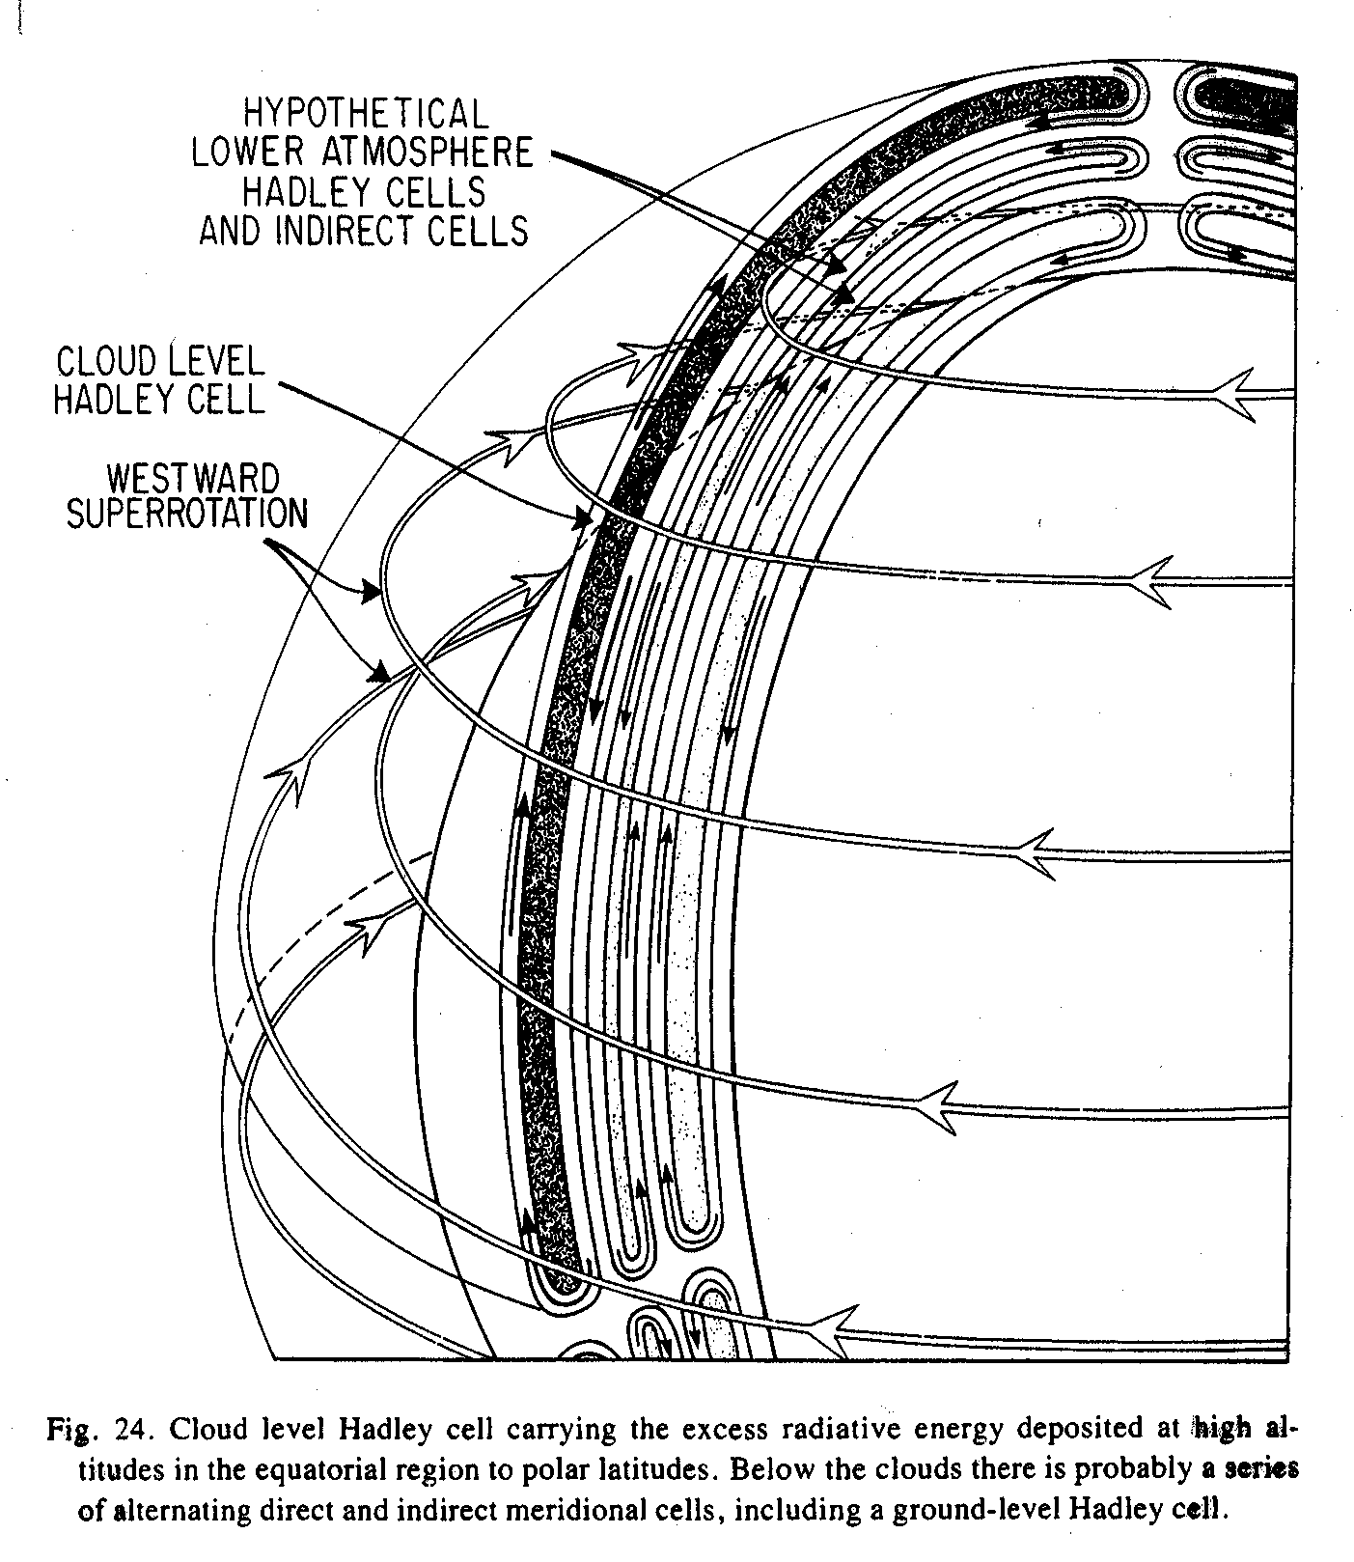
Venus circulation/clouds
Due to the slow rotation, Venus, dynamically, is an “all tropics” planet—Rossby number >> 1 everywhere.
Unlike Earth, Venus exhibits a global (equator-to-pole) Hadley circulation.
The atmosphere superrotates, carrying cloud-level air around the planet in 4 days—60 times faster than the underlying planet moves!
This means that the atmosphere has much more angular momentum per unit mass than the planet itself—a major puzzle.
The clouds form a global deck at about 50-60 km altitude, which may trigger local convection and gravity waves that may be important for the circulation.
Despite the clouds, the planet is very dry

Slide 40

Mars
Mars has a thin (0.006 bar) atmosphere of CO₂. Liquid water is not stable at the surface.
Greenhouse effect is weak due to low pressure, despite having a column abundance of CO₂ ~15 times greater than that on Earth. Atmospheric dust has a strong effect on thermal structure.
Mars has the most Earth-like weather of any planet in the Solar system, because of its similar length of day (24.6 hours) and axial tilt (25 deg).
So circulation regime is similar: Hadley cell at low latitudes, geostrophic flow comprising a baroclinic zone and jet streams at high latitudes, where Ro~0.1. Heat transported to poles by baroclinic instabilities.
Mars gives an example of weather and climate on a dry world. Comparing the behavior of Hadley cell, jets, instabilities on Mars and Earth can yield insights into these processes generally, and the role of moisture in them.

Slide 41


Mars
Because of the thin atmosphere, the radiative time constant is short on Mars, leading to larger equator-pole and day-night temperature differences. This leads to faster winds and strong seasonal cycles.
equinox
solstice
Temperature (K)
Diagnosis of zonal winds from observed temperatures using thermal-wind analysis:
Smith (2008)
Zonal wind (m/sec)

Slide 42



Mars climate: dust storms
How these dust storms work, including why they sometimes become global, is not well understood!

Slide 43

Water ice on Mars
Liquid water is not stable at Mars’ surface today, but the planet has significant reservoirs of ice at high latitudes. We know from the Gamma Ray Spectrometer on the Mars Odyssey spacecraft that the uppermost ~1 m of much of the polar regions of Mars (latitudes > 60 deg) is dominated by a hydrogen-bearning material, probably water ice. The ice could extend significantly deeper.
Boynton et al. (2002)

Slide 44


Mars polar caps
The topography within 10 deg of both poles is locally elevated, and is known from radar, imaging, and other data to consist of a water-ice deposit ~2 km thick and ~1000 km across. These are the north and south polar layered deposits.
Outcrops and radar exhibit fine-scale layering, probably layers of a few % dust intermixed with the ice. This layering records episodic deposition associated with climate cycles over millions of years.
Byrne (2009, Annu. Rev.)

Slide 45


Ice ages on Mars
Both poles have water ice caps 1-2 km deep, and subsurface ice exists to latitudes ~60 deg, where it is stable.
Yet, evidence exists for ice glaciers at low latitudes where the ice is not currently stable
Mars’ obliquity oscillates, and climate models show that, at high obliquity, ice is stable at low latitudes (and less so at poles)
Thus, we seem to be witnessing a form of ice ages on Mars—ice oscillates between low and high latitudes in response to Milankovitch cycles
There are numerous unanswered questions about how this works and analogies with Milankovitch cycles and ice ages on Earth.
Low-latitude glaciers (Head et al. 2005, Shean et al. 2007):

Slide 46



Long-term climate on Mars
Numerous channels and valley networks suggest that Mars had a warmer, wetter past.
But how warm? How wet? Did it once have a thicker CO₂ atmosphere with a significant greenhouse effect?
If so, where did the atmosphere go?
And was the planet ever habitable?

Slide 47

Titan
Titan is an icy satellite of Saturn with a thick (1.5 bar) N₂ atmosphere and a surface temperature of 97 K. The “bedrock” is H₂O. Radius 2500 km, gravity 1.3 m/s².
Methane forms a hydrological cycle like water on Earth—methane evaporates out of surface lakes, forms clouds, and rains, carving valleys in the ice.
Only other terrestrial planet besides Earth with a thick N₂ atmosphere, and with an active hydrological cycle!
Photolysis of atmospheric methane leads to escape of hydrogen to space and production of higher-order hydrocarbons, many of which are liquids or solids. This produces a global, opaque, high-altitude haze layer, which obscures the surface from view. These materials slowly settle down onto the surface.
If not resupplied, all of Titan’s atmospheric methane would be destroyed by photolysis in ~10⁷ years. The existence of atmospheric methane thus suggests that methane is resupplied from the surface to the atmosphere.

Slide 48



It was thought in the 1980s to ~2000 that, over solar-system history, photolysis of all that methane would lead to a global layer of ethane ~0.5 km thick. Thus global oceans of ethane (and dissolved methane) were predicted.
Groundbased data, Cassini and Hugyens showed that there is no global ocean but a desert-like landscape with river valleys, sand dunes, etc, with lakes near the poles.
It’s unclear where the missing organics are. Some may be below-ground in an aquifer. Some may be in solid form. Or perhaps Titan didn’t always have abundant atmospheric methane over its history, which would mean that less ethane would have been produced.

Slide 49


Thermal structure and humidity
Titan has a well-defined troposphere 40 km thick, overlain by a stratosphere and a thermosphere. Here are measurements from the Huygens probe. Wiggles are caused by atmospheric waves.
Methane is cold trapped at the tropopause, but because of the low latent heat of methane, the effect is not strong. The (constant) mole fraction of methane in the stratosphere is only a factor of several less than at the surface.
This helps enable irreversible methane destruction/loss over time.
This differs from Earth, where stratospheric water vapor is ~10⁴ times less than at the tropical surface.

Slide 50


Titan circulation
Titan is a slow rotator (16 day period), meaning it is (nearly) an “all tropics” world
Hadley cell is nearly global; like Venus, Titan lacks an extensive “baroclinic zone”
Like Venus, Titan’s atmosphere superrotates. Comparisons of Venus and Titan may help elucidate the mechanism.
Hazes exhibit considerable structure and seasonality, and rainstorms can be monitored from Earth and spacecraft
Local methane clouds

